Slide 1
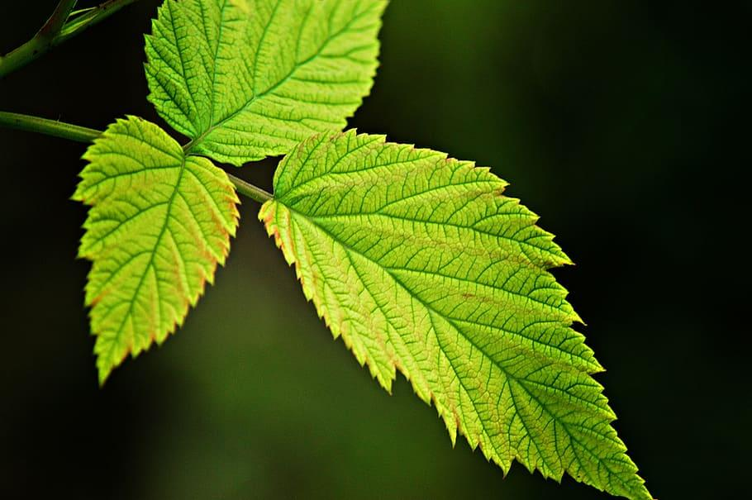
Photosynthesis

Slide 2
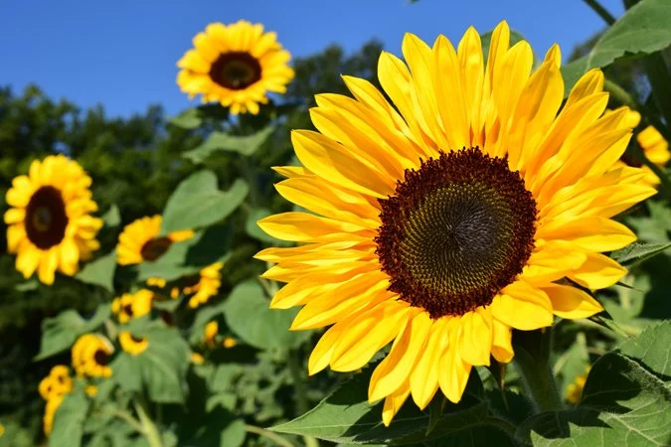
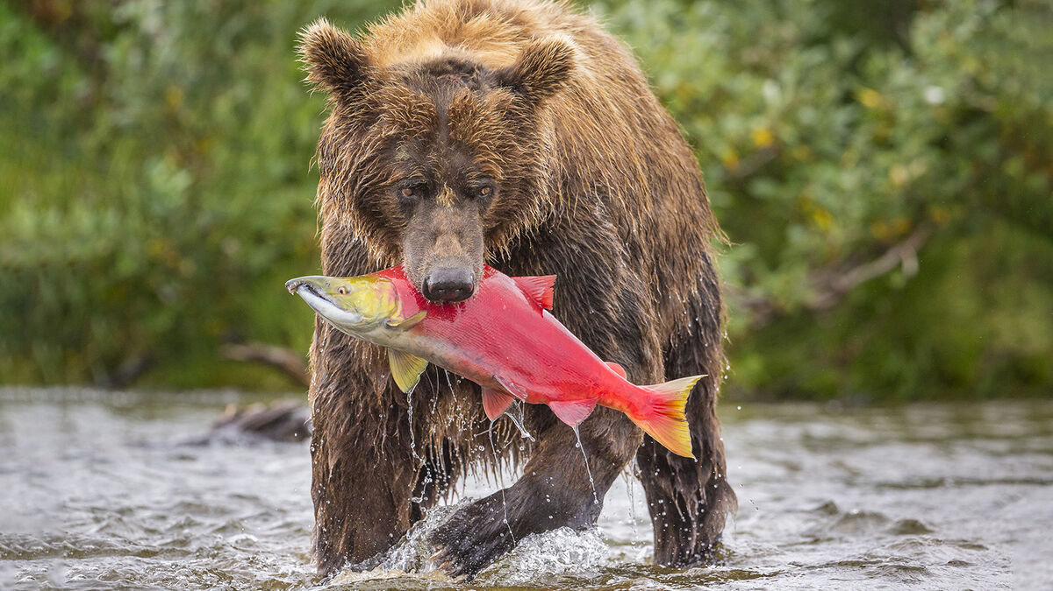
How Organisms Obtain Energy
Autotrophs (AKA Producers): make their own food by building organic molecules
Heterotrophs (AKA Consumers): Obtain energy from foods they consume

Slide 3
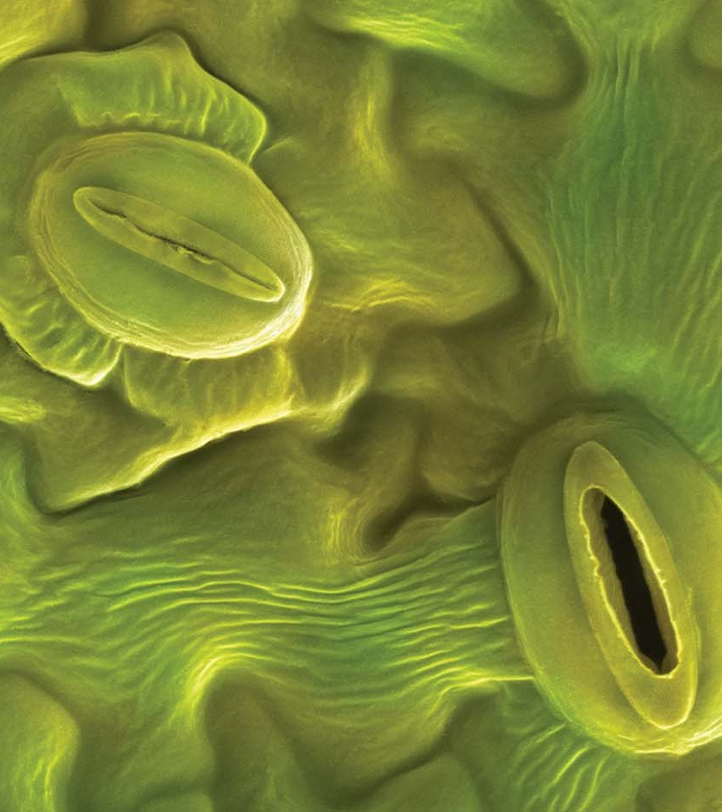
Plant Anatomy Basics
Roots: soak up water and nutrients from the soil, may also serve to store extra sugars
Stems: bring water and nutrients to different parts of the plant via capillary action
Leaves: exchange gasses and water between the plant and air through the tiny openings called stomata
Transpiration: evaporation through the stomata of a plant

Slide 4
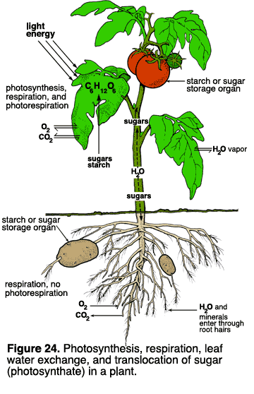
What do plants need?
Need to collect light energy →leaves
Need to store light energy → chloroplasts
Need to get the building block atoms from the environment (C, H, O, N, P, S, K, Mg) → stomata (CO2 and O2) and roots (water, nutrients)
Need to produce the organic molecules necessary for growth
  Carbs, lipids, proteins, and nucleic acids!

Slide 5
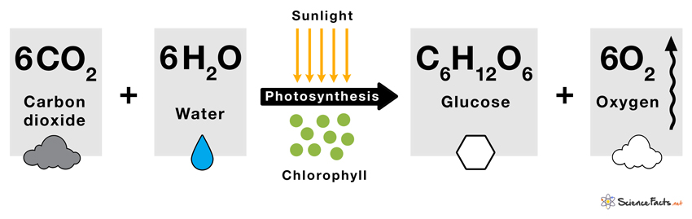
Photosynthesis Equation
How is this equation similar to the equation for cellular respiration?

Slide 6
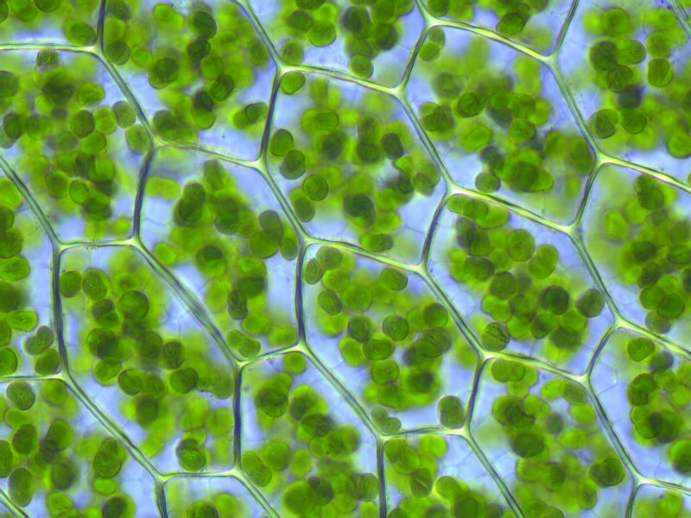
The Chloroplast
Photosynthesis occurs inside the chloroplast
Two main parts:
  Grana: Stacks of thylakoids
  Stroma: Fluid inside of the chloroplast
Thylakoid membrane contains:
  Chlorophyll molecules
  Electron Transport Chain
  ATP Synthase
Double membrane, ribosomes, and DNA just like mitochondria!

Slide 7
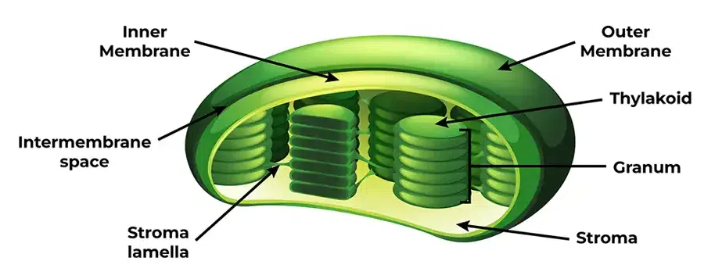

Slide 8
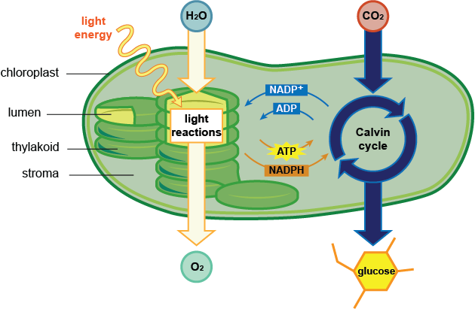
Photosynthesis Overview
Two sets of reactions happen inside the chloroplast
Light reactions (Light dependent)- sunlight to ATP
Calvin Cycle (Light independent)- CO2 to glucose

Slide 9
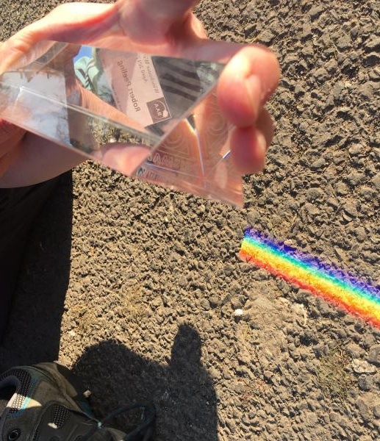
Light Absorption
Visible light is made of different wavelengths
The wavelength determines the color of the light
Sunlight is “white” light made up of a mixture of different wavelengths

Slide 10
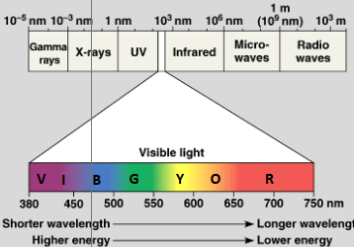
The Spectrum of Color

Slide 11
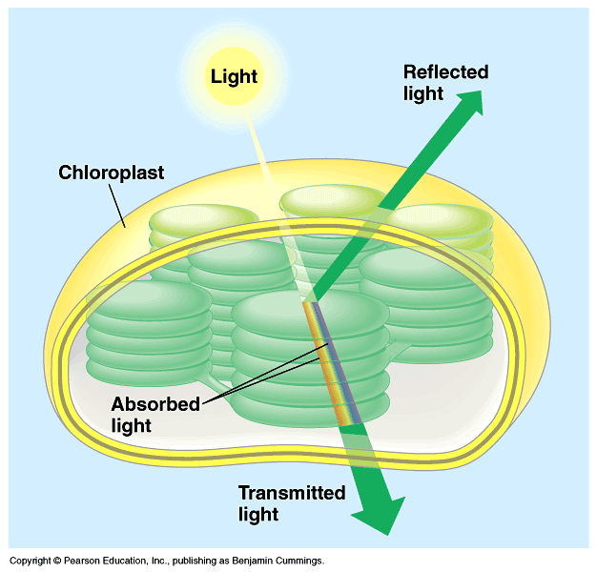
Pigments of Photosynthesis
Chlorophyll and other pigments embedded in the thylakoid membrane are responsible for light absorption
Chlorophyll a: absorbs best in red and blue wavelengths of light
Accessory pigments help absorb other wavelengths (ex. chlorophyll b, carotenoids, and xanthophylls)

Slide 12
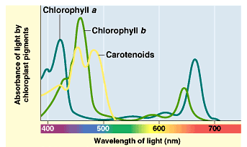
Which color of light do plants not absorb?

Slide 13
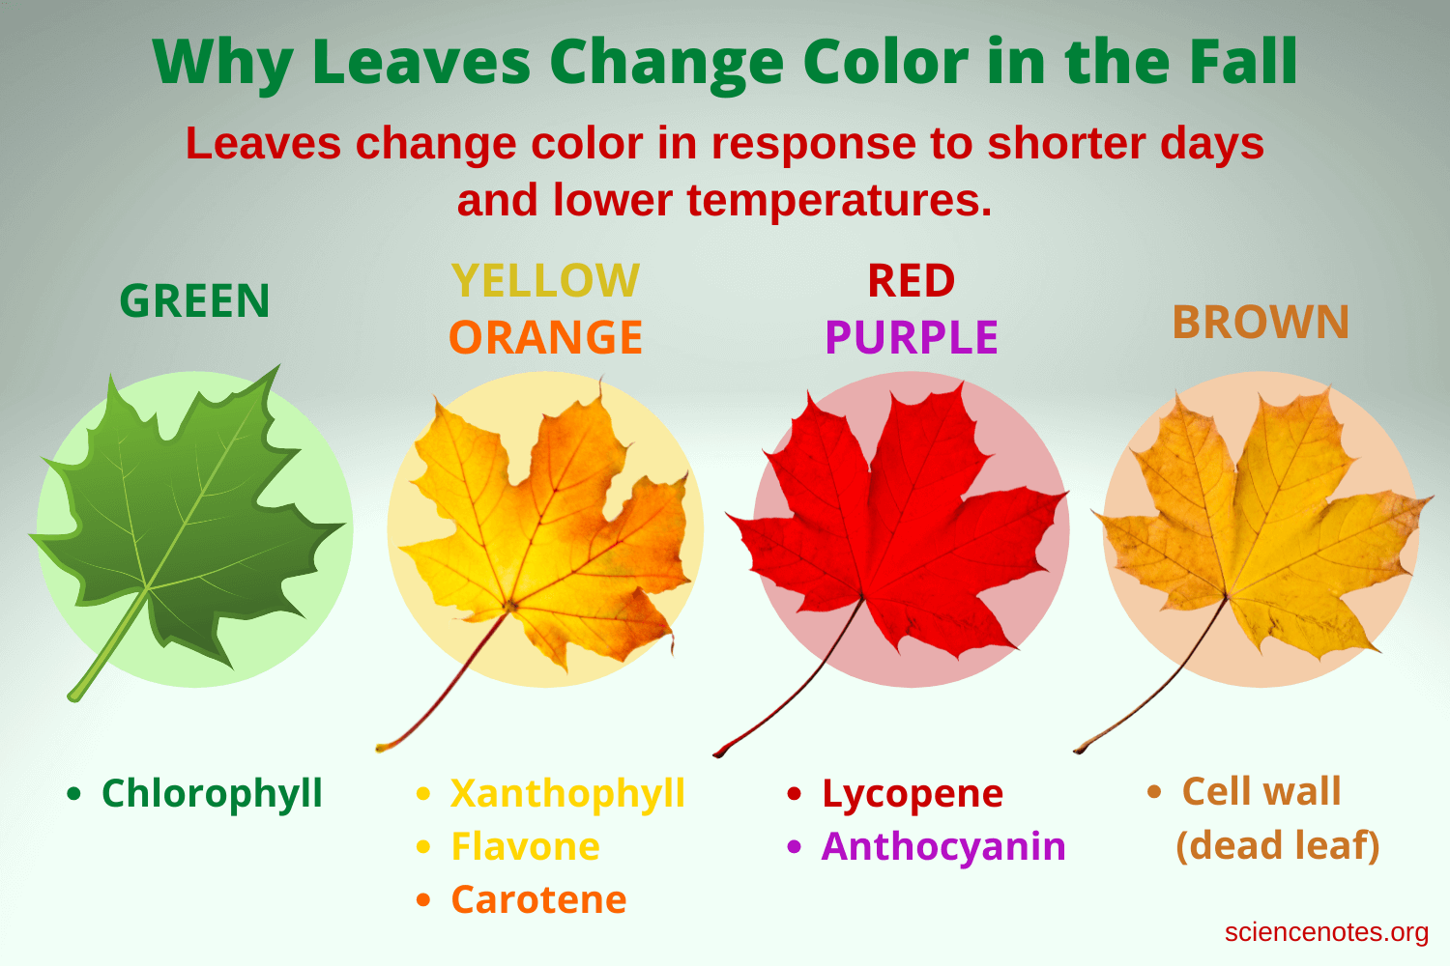
Pigments of Photosynthesis
Accessory pigments absorb light energy in other portions of the light spectrum
Include: chlorophyll b, carotene (red/orange pigment), and xanthophylls
Why do leaves change in the fall?
  Temperature drops cause a decrease in chlorophyll A and B production
  Allows accessory pigments (red, orange, and yellow) to show turning the leaf a different color

Slide 14
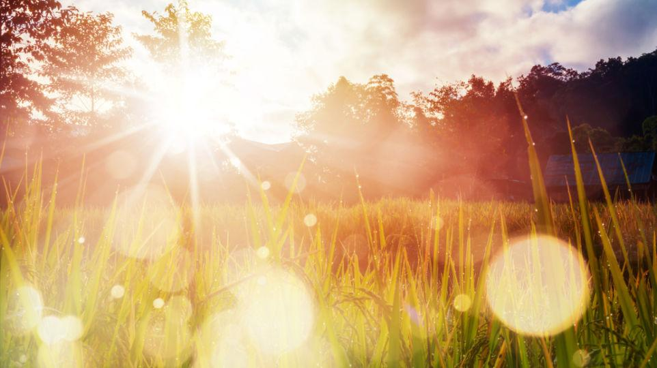
Light Dependent Reactions

Slide 15
Light Reactions Overview
Location: Thylakoid membrane
Summary: chlorophyll absorbs light and converts it into chemical energy (ATP and NADPH)
Water goes in and oxygen comes out as a byproduct
Two photosystems (I and II) play a part in light reactions
  Photosystems= large complexes of proteins and pigments

Slide 16
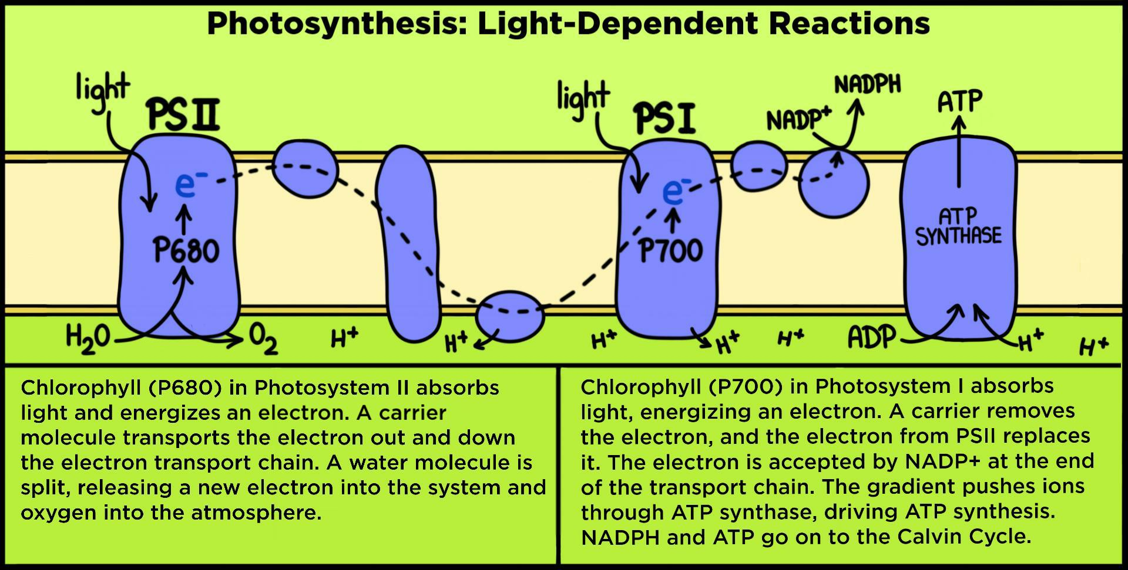
Light Reactions
Like cellular respiration there is an ETC to create a H+ gradient!
ETC uses light energy to produce ATP and NADPH to power the Calvin cycle
ETC 1 pairs with photosystem II to make ATP
ETC 2 pairs with photosystem I to make NADPH
ETC 2
ETC 1

Slide 17
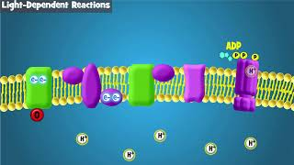
Light Reactions Video

Slide 18
Step 1: Photosystem II/ETC 1
Light is absorbed by pigments in PSII and electrons in chlorophyll become excited (high energy)
Electrons leave chlorophyll and enter the ETC
Water is split into H+, e-, and O₂ (replenishes electrons)
Energy from electrons power the ETC and move H+ INTO the thylakoid
H+ diffuses back out to the stroma through ATP synthase to produce ATP
Where does the oxygen go?

Slide 19
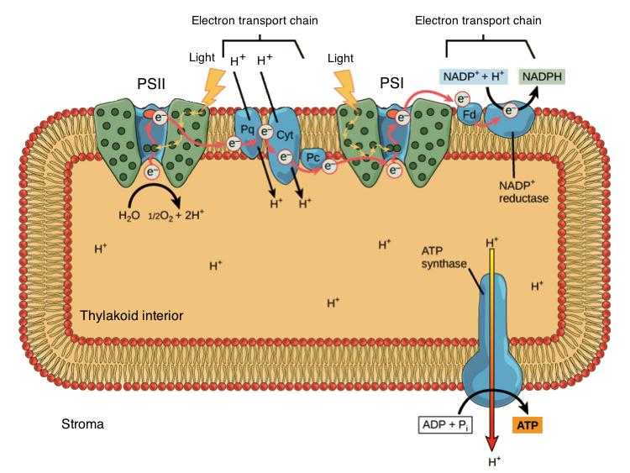
Photosystem II/ETC 1 (Step 1)

Slide 20
Step 2: Photosystem I/ETC 2
Electrons from PSII enter PS I and get re-energized with light absorbed by pigments
As e-’s move into ETC 2 an enzyme called NADP+ reductase reduces NADP+ into NADPH (accepts electrons)
NADPH and ATP are now in the stroma ready to power the light independent reactions (Calvin cycle)

Slide 21
Photosystem I/ETC 2 (Step 2)

Slide 22
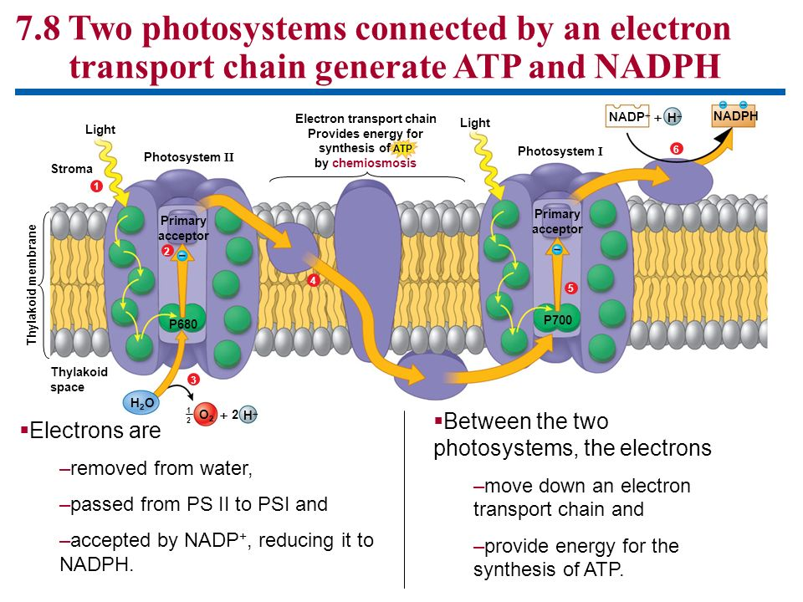

Slide 23
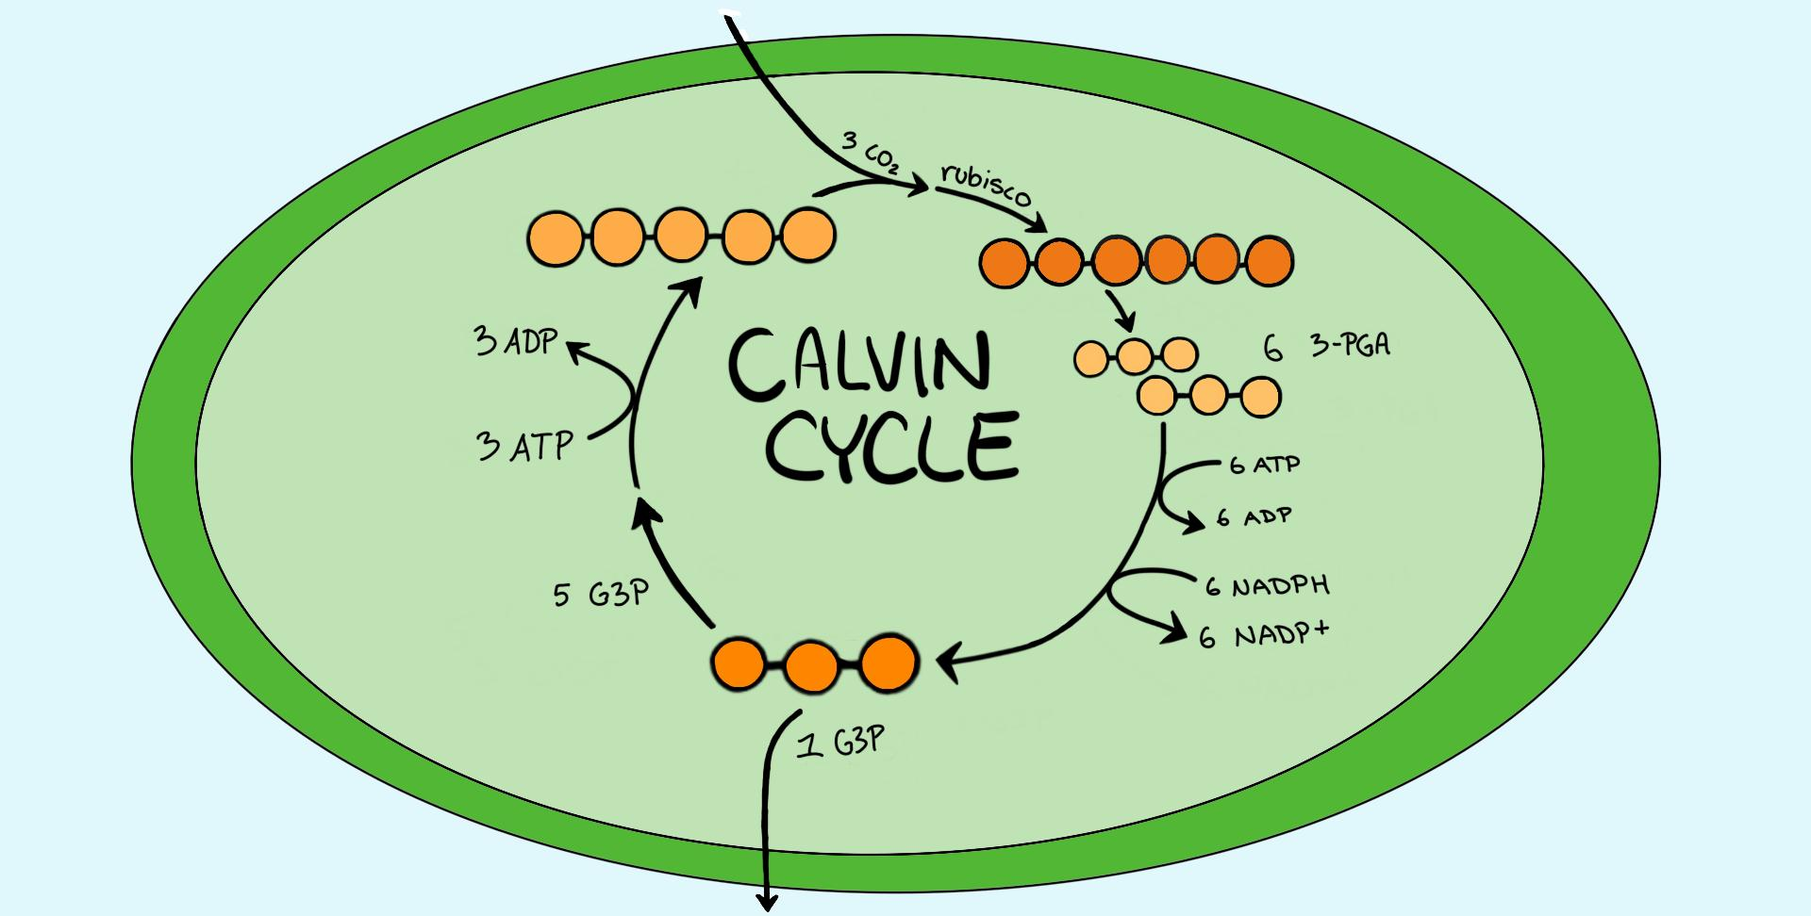

Slide 24
Review: What do plants need?
Plants need to produce their own organic molecules necessary for growth
What do we already have?
  ATP and NADPH (chemical energy) from light rxns
Plants need to store this chemical energy in a more stable form 🡪 we will store it into organic molecules (glucose!)
Where is this sugar stored? (...think back to Unit 1 again)

Slide 25
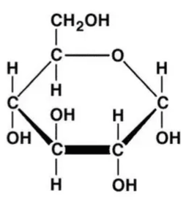
How is Glucose Made?
Glucose = C₆H₁₂O₆
CO₂ that enters the plant through stomata can be “fixed” (incorporated into organic molecules) and used to build sugars
  In this process CO₂ is reduced
ATP and NADPH power this reaction

Slide 26
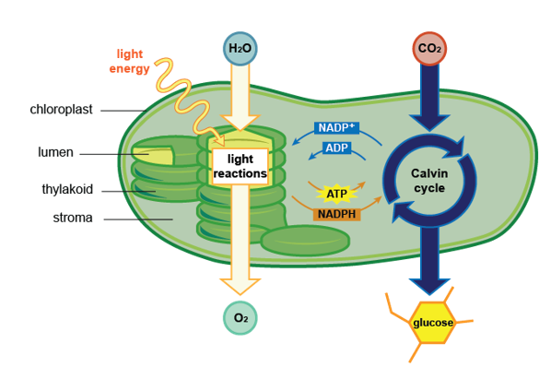
Calvin Cycle Overview
Location: stroma inside chloroplasts
Powered by energy generated in light reactions
CO2 has very little chemical energy
  Calvin cycle converts CO₂ into C₆H₁₂O₆ which has a lot of chemical energy
Synthesizing glucose=endergonic process completed by reducing CO₂

Slide 27
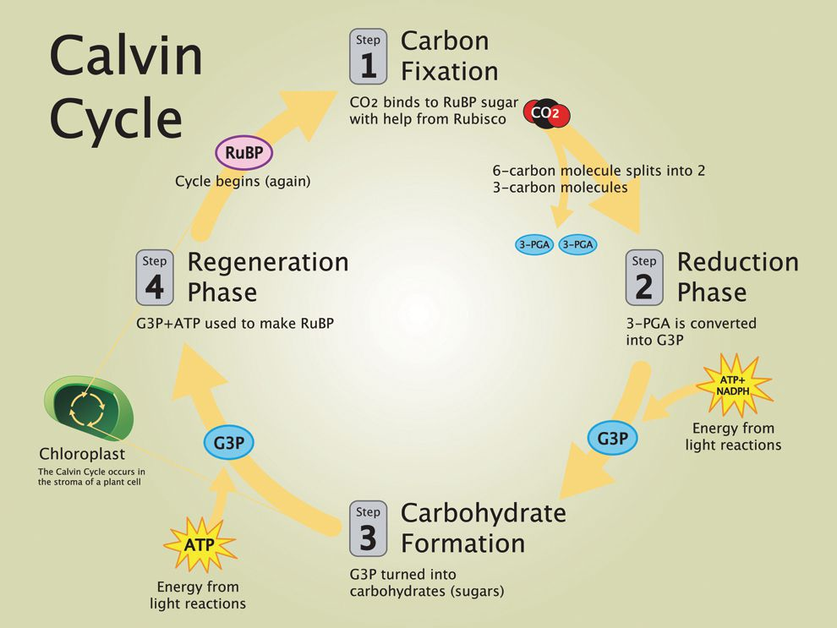
The Calvin Cycle
RuBP is a 5C molecule; gets combined with CO2 by RuBisCo enzyme
3 Major phases:
Carbon Fixation (Carboxylation) of CO2 by RuBisCo
Reduction of 3-PGA to G3P
Regeneration of RuBP
G3P is used to make glucose, starch, cellulose, etc.

Slide 28
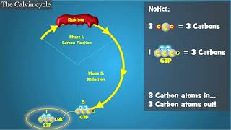
Calvin Cycle Video

Slide 29
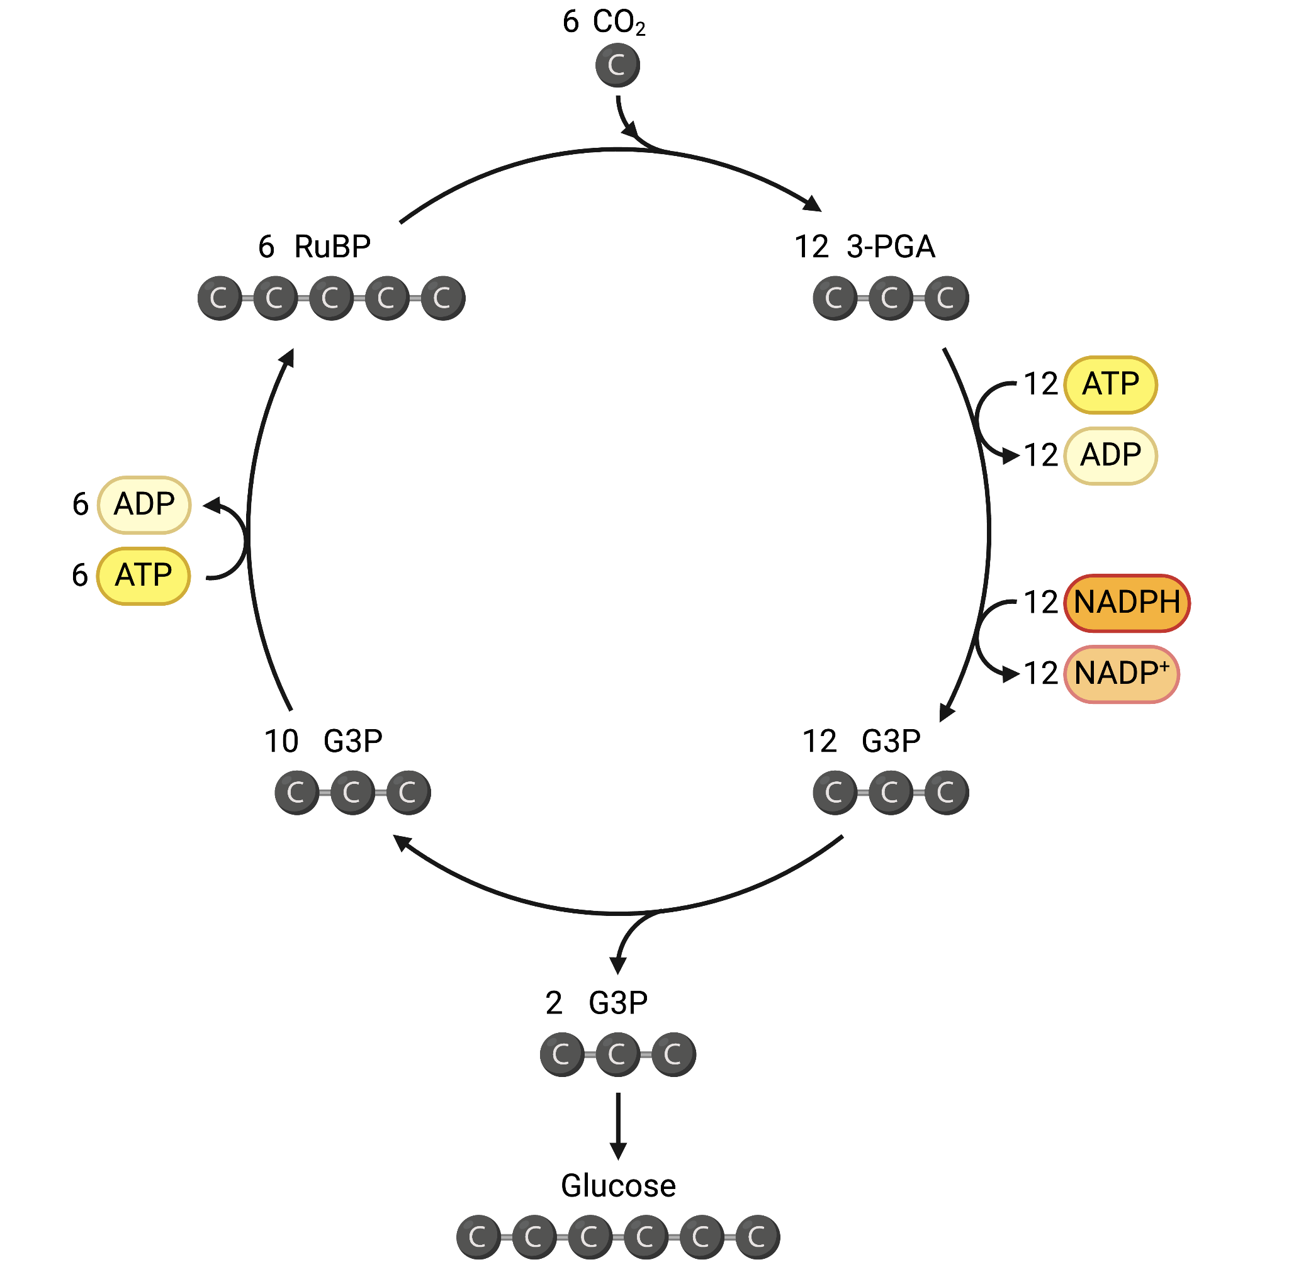
The Calvin Cycle
Step 1: Carbon Fixation
Step 2: Reduction
Step 3: Regeneration
2 G3P used to make glucose- the rest are recycled!

Slide 30
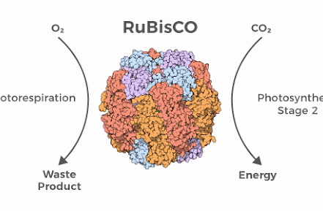
Carbon Fixing Enzyme
RuBisCo= ribulose bisphosphate carboxylase
Enzyme that fixes carbon from the CO₂ in the air
Most important and abundant enzyme on earth 🡪 makes life out of air!

Slide 31
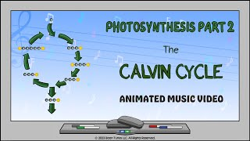
Calvin Cycle Summary
During 6 turns of the Calvin cycle:
  6 CO₂ 🡪 1 C₆H₁₂O₆
  18 ATP and 12 NADPH are used (where from?)
Any leftover ATP will be used elsewhere by the cell

Slide 32
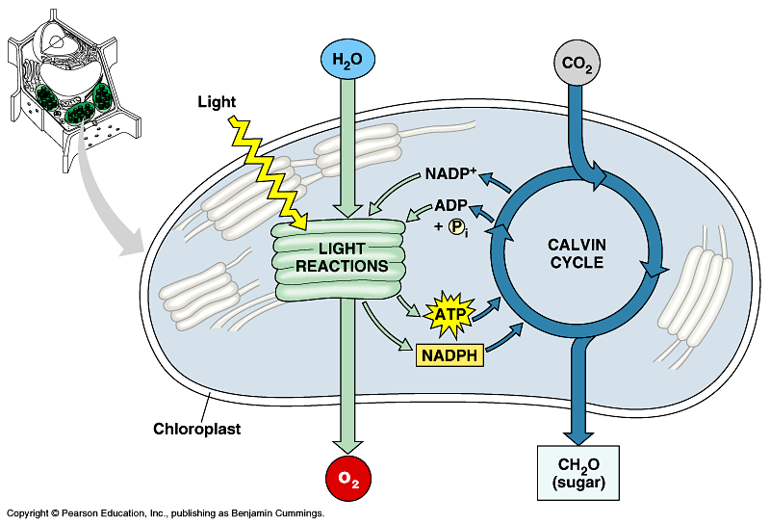
Summary of Photosynthesis
Light Reactions:
  Uses H₂O
  Produces ATP and NADPH
  Releases O₂ as a byproduct
Calvin Cycle
  Uses CO₂
  Produces C₆H₁₂O₆
  Regenerates ADP and NADP+

Slide 33
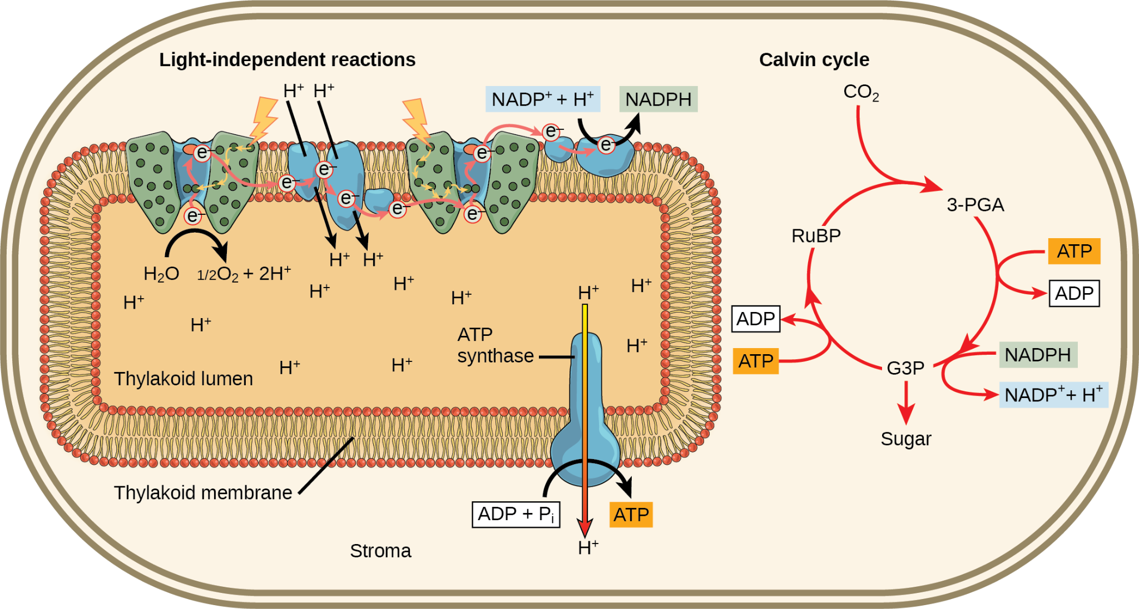
Summary of Photosynthesis

Slide 34
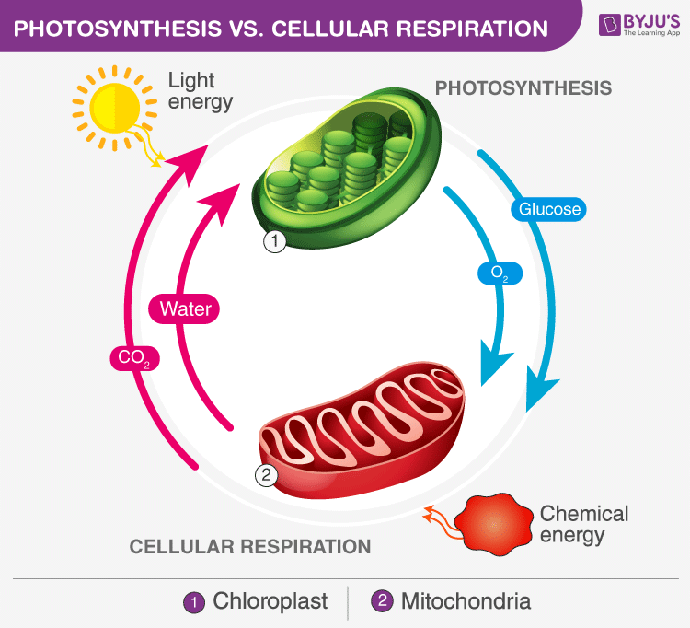
The Energy Cycle

Slide 35
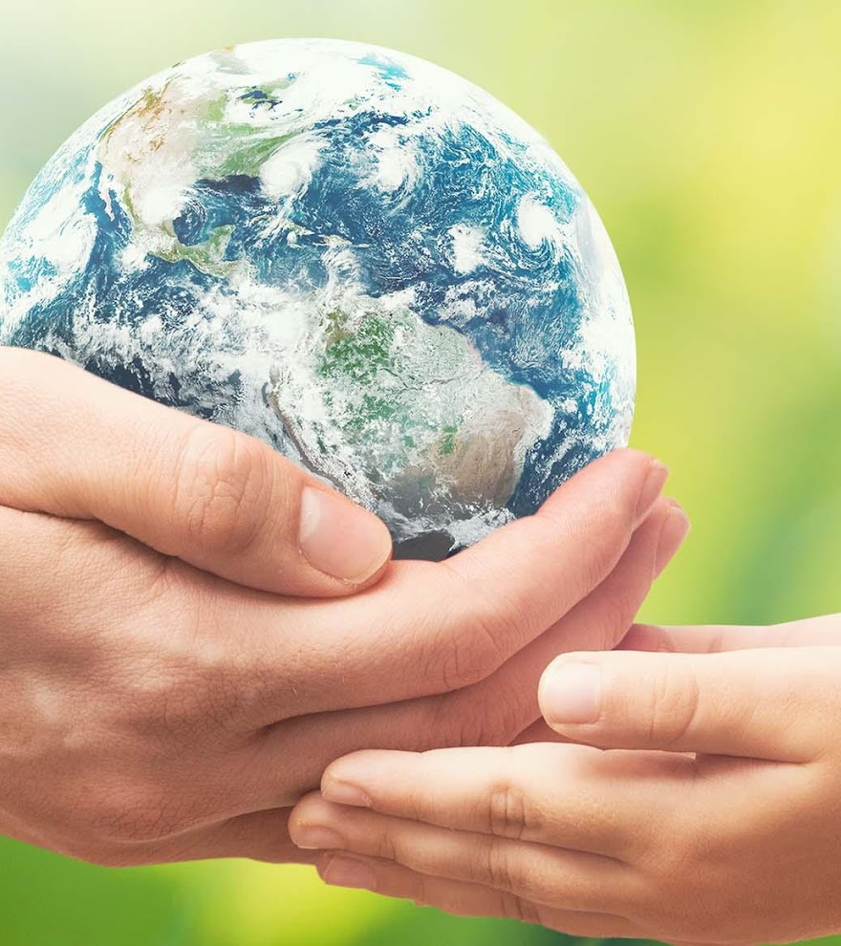
Supporting a Biosphere
On a global scale, photosynthesis is the most important process to life on Earth
Each year photosynthesis:
  Captures 121 billion tons of CO2
  Synthesizes 275 billion tons of carbohydrates
Producers and consumers depend on each other to be able to carry out life’s processes!

Slide 36
